Slide 1
C++ is Fun – Part 12 at Turbine/Warner Bros.!
Russell Hanson

Slide 2
Syllabus
1) First program and introduction to data types and control structures with applications for games learning how to use the programming environment Mar 25-27
2) Objects, encapsulation, abstract data types, data protection and scope April 1-3
3) Basic data structures and how to use them, opening files and performing operations on files – April 8-10
4) Algorithms on data structures, algorithms for specific tasks, simple AI and planning type algorithms, game AI algorithms April 15-17
Project 1 Due – April 17
5) More AI: search, heuristics, optimization, decision trees, supervised/unsupervised learning – April 22-24
6) Game API and/or event-oriented programming, model view controller, map reduce filter – April 29, May 1
7) Basic threads models and some simple databases SQLite May 6-8
8) Graphics programming, shaders, textures, 3D models and rotations May 13-15
Project 2 Due May 15
9) How to download an API and learn how to use functions in that API, Windows Foundation Classes May 20-22
10) Designing and implementing a simple game in C++ May 27-29
11) Selected topics – Gesture recognition & depth controllers like the Microsoft Kinect, Network Programming & TCP/IP, OSC June 3-5
12) Working on student projects - June 10-12
Final project presentations Project 3/Final Project Due June 12

Slide 3
Woah! Tic Tac Toe!!!
Welcome to Tic-Tac-Toe
You will make your move by entering a number, 0-8.
The number will correspond to the board position as illustrated:
0 | 1 | 2
3 | 4 | 5
6 | 7 | 8
You want to go first? (y/n) : y
You want to be X or O? (x/o) : X
You want to be X or O? (x/o) : x
| | |
| | |
| | |
Where do you want to move? (0 - 8): 0
X | | |
| | |
| | |
X | | |
| O | |
| | |
Where do you want to move? (0 - 8): 8
X | | |
| O | |
| | X |
X | | O |
| O | |
| | X |
Where do you want to move? (0 - 8): 6
X | | O |
| O | |
X | | X |
X | | O |
| O | |
X | O | X |
Where do you want to move? (0 - 8): 1
X | X | O |
| O | |
X | O | X |
X | X | O |
O | O | |
X | O | X |
Where do you want to move? (0 - 8): 5
X | X | O |
O | O | X |
X | O | X |
TIE!
sh: PAUSE: command not found
Russells-MacBook-Pro:mgraessle_Homework4 russell$
X | | O |
| O | |
X | O | X |
Where do you want to move? (0 - 8): 1
X | X | O |
| O | |
X | O | X |
X | X | O |
O | O | |
X | O | X |
Where do you want to move? (0 - 8): 5
X | X | O |
O | O | X |
X | O | X |
TIE!
sh: PAUSE: command not found
Russells-MacBook-Pro:mgraessle_Homework4 russell$

Slide 4
/*
Use the current empty pieces to have the computer
choose the best move to counter the last human move
*/
void Board::computerMove()
{
// set the list of all the ways to win
int WAYS_TO_WIN [8][3] = {{0, 1, 2},
{3, 4, 5},
{6, 7, 8},
{0, 3, 6},
{1, 4, 7},
{2, 5, 8},
{0, 4, 8},
{2, 4, 6}};
// if computer can win, take that move
for (int i = 0; i < 8; ++i)
{
if ( board_pieces[WAYS_TO_WIN[i][0]] == COMPUTER && board_pieces[WAYS_TO_WIN[i][1]] == COMPUTER && board_pieces[WAYS_TO_WIN[i][2]] == EMPTY) {
setPiece(WAYS_TO_WIN[i][2], COMPUTER);
return;
}
else {
if ( board_pieces[WAYS_TO_WIN[i][1]] == COMPUTER && board_pieces[WAYS_TO_WIN[i][2]] == COMPUTER && board_pieces[WAYS_TO_WIN[i][0]] == EMPTY) {
setPiece(WAYS_TO_WIN[i][0], COMPUTER);
return;
}
else {
if ( board_pieces[WAYS_TO_WIN[i][0]] == COMPUTER && board_pieces[WAYS_TO_WIN[i][2]] == COMPUTER && board_pieces[WAYS_TO_WIN[i][1]] == EMPTY )
{
setPiece(WAYS_TO_WIN[i][1], COMPUTER);
return;
}
}
}
}
// if human can win, block that move
for (int i = 0; i < 8; ++i)
{
if ( board_pieces[WAYS_TO_WIN[i][0]] == HUMAN && board_pieces[WAYS_TO_WIN[i][1]] == HUMAN && board_pieces[WAYS_TO_WIN[i][2]] == EMPTY) {
setPiece(WAYS_TO_WIN[i][2], COMPUTER);
return;
}
else {
if ( board_pieces[WAYS_TO_WIN[i][1]] == HUMAN && board_pieces[WAYS_TO_WIN[i][2]] == HUMAN && board_pieces[WAYS_TO_WIN[i][0]] == EMPTY) {
setPiece(WAYS_TO_WIN[i][0], COMPUTER);
return;
}
else {
if ( board_pieces[WAYS_TO_WIN[i][0]] == HUMAN && board_pieces[WAYS_TO_WIN[i][2]] == HUMAN && board_pieces[WAYS_TO_WIN[i][1]] == EMPTY )
{
setPiece(WAYS_TO_WIN[i][1], COMPUTER);
return;
}
}
}
}
int BEST_MOVES[10] = {4, 0, 2, 6, 8, 1, 3, 5, 7};
// if one of the best squares is empty, take it
for (int i = 0; i < 10; ++i)
{
if ( isMoveLegal(BEST_MOVES[i]) )
{
setPiece(BEST_MOVES[i], COMPUTER);
break;
}// end if
}// end for
}// end computerMove

Slide 5
/*
Use the current empty pieces to have the computer
choose the best move to counter the last human move
*/
void Board::computerMove()
{
// set the list of all the ways to win
int WAYS_TO_WIN [8][3] = {{0, 1, 2},
{3, 4, 5},
{6, 7, 8},
{0, 3, 6},
{1, 4, 7},
{2, 5, 8},
{0, 4, 8},
{2, 4, 6}};
// if computer can win, take that move
for (int i = 0; i < 8; ++i)
{
if ( board_pieces[WAYS_TO_WIN[i][0]] == COMPUTER && board_pieces[WAYS_TO_WIN[i][1]] == COMPUTER && board_pieces[WAYS_TO_WIN[i][2]] == EMPTY) {
setPiece(WAYS_TO_WIN[i][2], COMPUTER);
return;
}
else {
if ( board_pieces[WAYS_TO_WIN[i][1]] == COMPUTER && board_pieces[WAYS_TO_WIN[i][2]] == COMPUTER && board_pieces[WAYS_TO_WIN[i][0]] == EMPTY) {
setPiece(WAYS_TO_WIN[i][0], COMPUTER);
return;
}
else {
if ( board_pieces[WAYS_TO_WIN[i][0]] == COMPUTER && board_pieces[WAYS_TO_WIN[i][2]] == COMPUTER && board_pieces[WAYS_TO_WIN[i][1]] == EMPTY )
{
setPiece(WAYS_TO_WIN[i][1], COMPUTER);
return;
}
}
}
}
// if human can win, block that move
for (int i = 0; i < 8; ++i)
{
if ( board_pieces[WAYS_TO_WIN[i][0]] == HUMAN && board_pieces[WAYS_TO_WIN[i][1]] == HUMAN && board_pieces[WAYS_TO_WIN[i][2]] == EMPTY) {
setPiece(WAYS_TO_WIN[i][2], COMPUTER);
return;
}
else {
if ( board_pieces[WAYS_TO_WIN[i][1]] == HUMAN && board_pieces[WAYS_TO_WIN[i][2]] == HUMAN && board_pieces[WAYS_TO_WIN[i][0]] == EMPTY) {
setPiece(WAYS_TO_WIN[i][0], COMPUTER);
return;
}
else {
if ( board_pieces[WAYS_TO_WIN[i][0]] == HUMAN && board_pieces[WAYS_TO_WIN[i][2]] == HUMAN && board_pieces[WAYS_TO_WIN[i][1]] == EMPTY )
{
setPiece(WAYS_TO_WIN[i][1], COMPUTER);
return;
}
}
}
}
int BEST_MOVES[10] = {4, 0, 2, 6, 8, 1, 3, 5, 7};
// if one of the best squares is empty, take it
for (int i = 0; i < 10; ++i)
{
if ( isMoveLegal(BEST_MOVES[i]) )
{
setPiece(BEST_MOVES[i], COMPUTER);
break;
}// end if
}// end for
}// end computerMove

Slide 6
Graphics and OpenGL!

Slide 15
Double Buffering

Slide 36
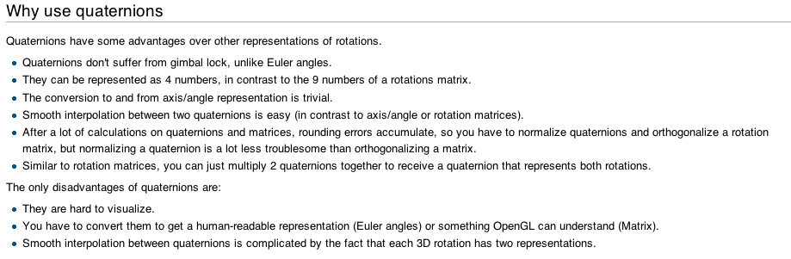

Slide 37
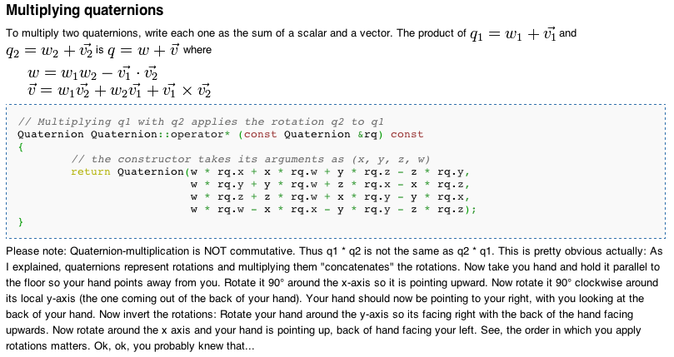

Slide 38
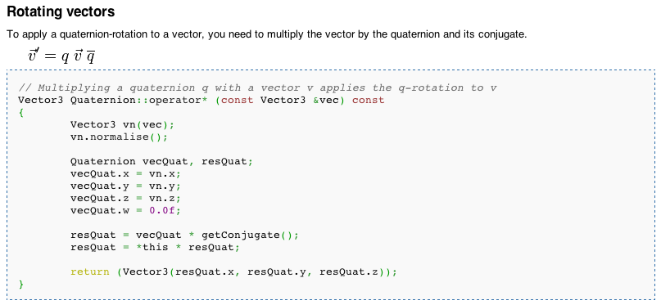

Slide 39
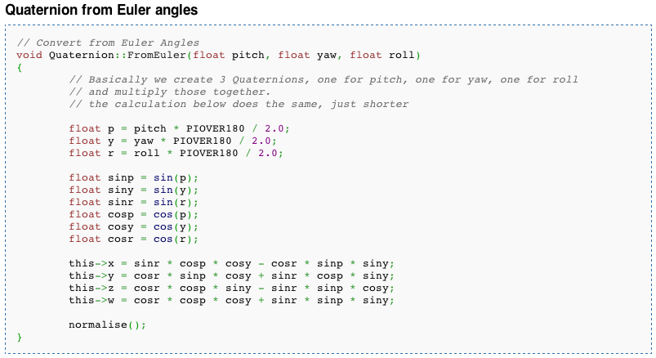

Slide 40
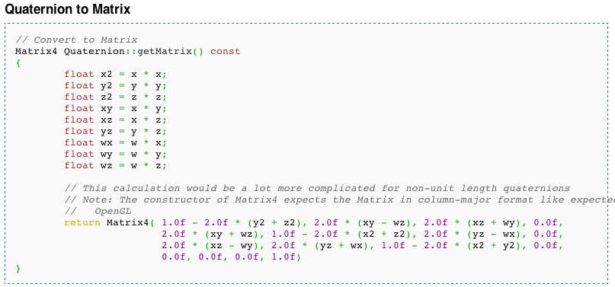

Slide 41
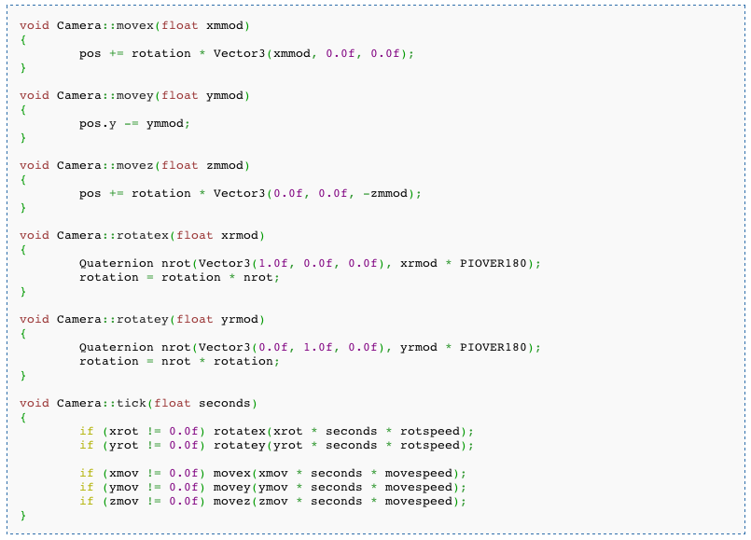

Slide 50
Some links:
http://www.glprogramming.com/manpages/opengl-quick-reference-card.pdf
The Official Guide to Learning OpenGL, Version 1.1 www.glprogramming.com/red/index.html
OpenGL Tutorial
http://www.loria.fr/~roegel/cours/iut/opengl/addison.pdf

